Slide 1

City of Chicago – Crime Analysis
Data source: https://data.cityofchicago.org/Public-Safety/Crimes-2022/9hwr-2zxp/data

Slide 2
Agenda
Problem Statement
Dashboards
1
5
Data & Tools Used
Conclusion
2
6
Exploratory Data Analysis
What more can be done ?
3
7
Analysis and Results
4

Slide 3


Problem Statement
A hypothesis has been proposed that crime and poverty levels are related.
Crime Analysis in City of Chicago
Notes:
Ethan
Mention Hackathon in a few words
Hackathon Problem Statement: "Zena batch schedule data is complex and current tools have limitations to enable efficient decision making and action."

Slide 4







Data & Tools Used
Processes followed and technologies used to accomplish the set goals
DataSets:
Crimes – 2001 to Present
Census Data - Selected socioeconomic indicators in Chicago
All the technologies listed are licensed for use

Slide 5
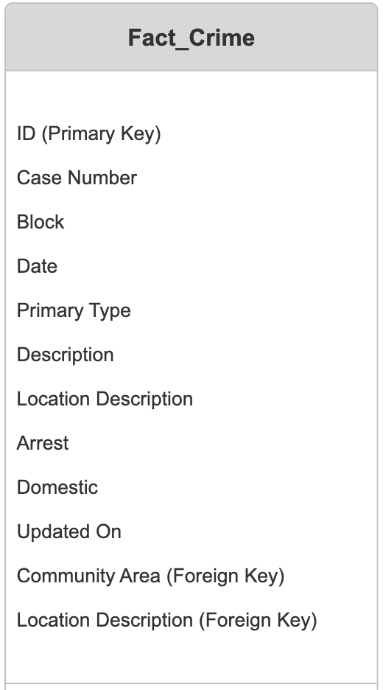
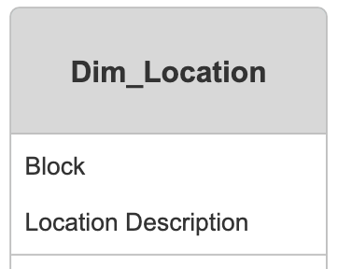
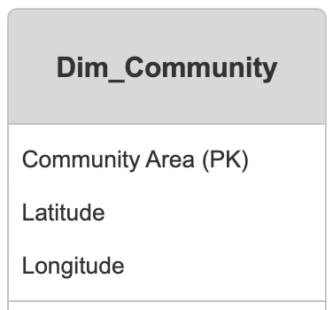
Exploratory Data Analysis
Understanding the Data keeping in mind the end goal
ER Diagram
Notes:
Made Dimension and Fact Table
Dimension Table:
A dimension table contains descriptive attributes, or dimensions, that provide context to the measurements stored in the fact table.
Each record in a dimension table represents a unique category, entity, or characteristic, such as time, location, product, or customer.
Dimension tables are typically relatively small compared to fact tables and are often used for filtering, grouping, and labeling data in analytical queries.
Example dimension tables: Time dimension (containing attributes like year, month, day), Product dimension (containing attributes like product ID, name, category), Customer dimension (containing attributes like customer ID, name, address).
Fact Table:
A fact table contains quantitative, numerical data, known as measures, along with foreign keys that reference the related dimension tables.
Each record in a fact table represents a specific event, transaction, or observation and contains data that can be aggregated or analyzed.
Fact tables typically contain large volumes of data and are the primary source for analysis in data warehousing.
Fact tables are often associated with business processes such as sales, inventory, financial transactions, or web traffic.
Example fact tables: Sales fact table (containing measures like revenue, quantity sold), Inventory fact table (containing measures like stock levels, order quantities), Web traffic fact table (containing measures like page views, visit duration).

Slide 6
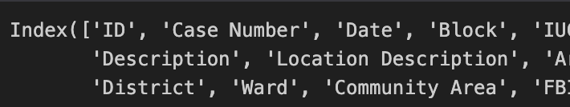
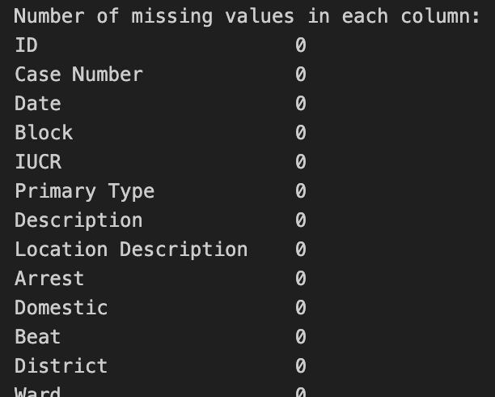
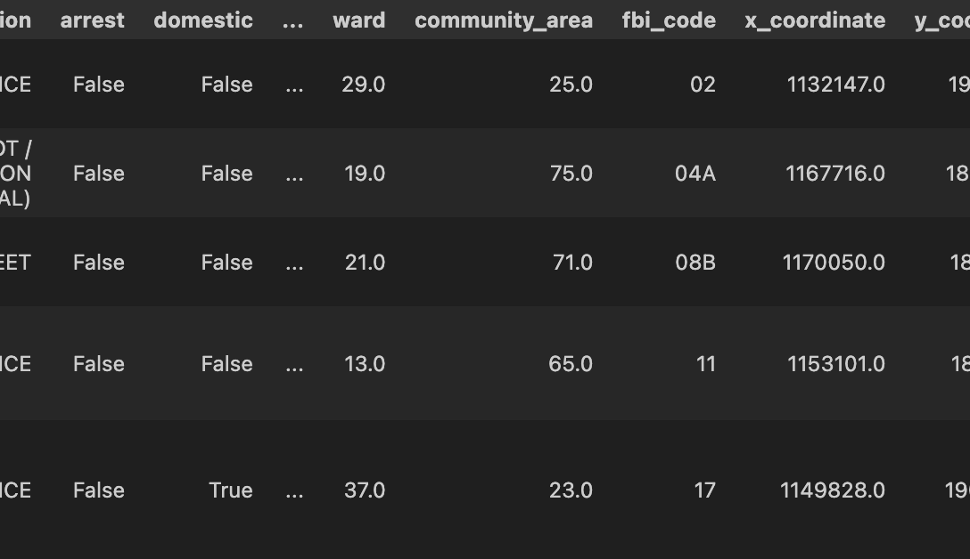
Exploratory Data Analysis
Handle Missing Values | Merging DataSets | Data Transformation | Kpi’s Detection
Notes:
Handling all the missing datas and merging them
Merging individual datasets - Left joins – Inner Joins
Methods used to extract data
Api calls
Live Extract tableau
Local Extract tableau

Slide 7
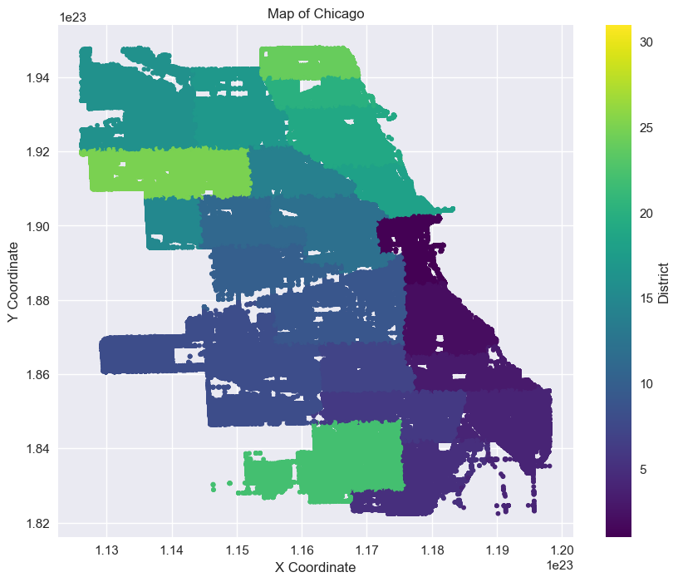
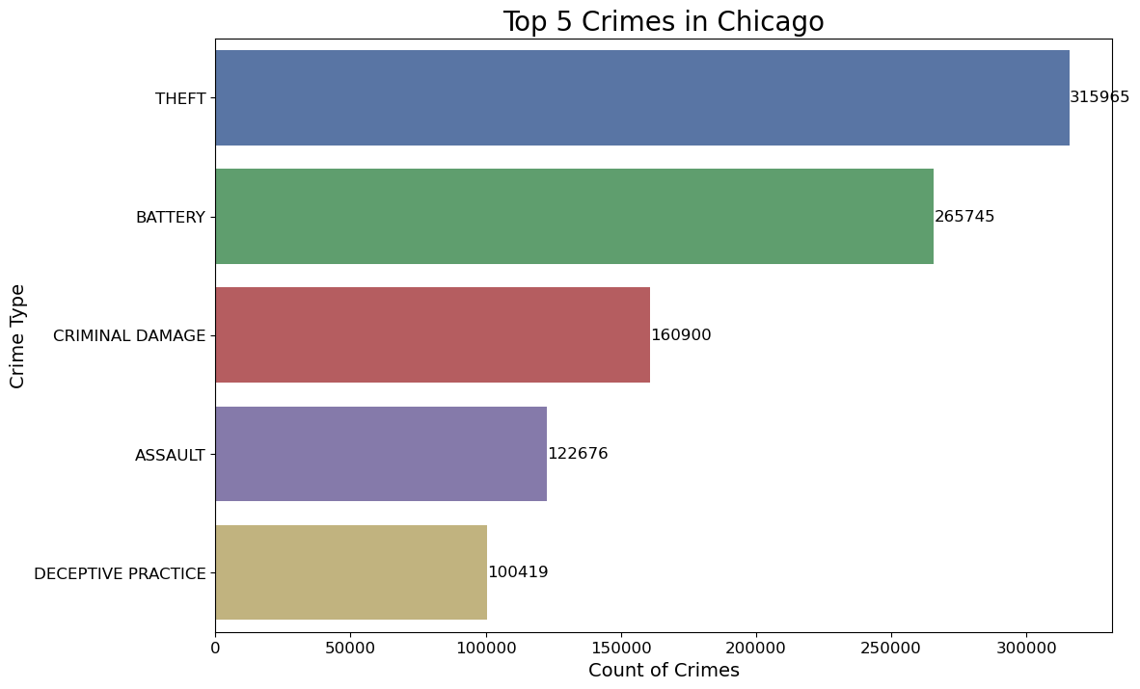
Exploratory Data Analysis
Visualizations
Notes:
Interesting part is this is a scatter plot and not a heatmap or a box plot
plt.style.use('seaborn'): Sets the style of the plot using the seaborn style.
top_5_crimes = df['Primary Type'].value_counts().sort_values(ascending=False).head(): Calculates the top 5 most frequent crime types in the dataset df.
temp = df.groupby('Primary Type', as_index=False).agg({"ID": "count"}): Groups the data by 'Primary Type' and counts the occurrences of each crime type, storing the result in a DataFrame called temp.
temp = temp.sort_values(by=['ID'], ascending=False).head(): Sorts the DataFrame temp based on the count of crimes (ID) in descending order and selects the top 5 crime types.
temp = temp.sort_values(by='ID', ascending=True): Further sorts the DataFrame temp based on the count of crimes (ID) in ascending order. This is not necessary and might be redundant.
sns.barplot(x='ID', y='Primary Type', data=temp, palette="Blues_d"): Creates a bar plot using seaborn's barplot function. The x-axis represents the count of crimes (ID), and the y-axis represents the crime types (Primary Type). The data used for plotting is the temp DataFrame. The color palette used for the bars is "Blues_d".
plt.title("Top 5 Crimes in Chicago", fontdict={'fontsize': 30, 'fontname':'Arial', 'color': '#000000'}): Sets the title of the plot to "Top 5 Crimes in Chicago" with specific font properties.
plt.xlabel("\nCOUNT OF CRIMES", fontdict={'fontsize': 15}): Sets the label for the x-axis to "COUNT OF CRIMES" with specific font properties.
plt.ylabel(""): No label for the y-axis is specified.
plt.xticks(rotation=90): Rotates the x-axis tick labels by 90 degrees for better readability.
plt.show(): Displays the plot.
This code snippet generates a rough map of Chicago using the X and Y coordinates of the crime incidents in the dataset. Here's an explanation of each component:
sns.lmplot(): This function is used to create a scatter plot with a linear regression line (though fit_reg=False disables this feature in this case). It is typically used for visualizing the relationship between two variables. In this case, it's used to plot the X and Y coordinates of the crime incidents.
'X Coordinate' and 'Y Coordinate': These parameters specify the columns from the DataFrame (df) to be plotted on the x-axis and y-axis, respectively. They represent the geographical coordinates of the crime incidents.
data=df: This parameter specifies the DataFrame containing the data to be plotted.
fit_reg=False: This parameter disables the fitting of a regression line to the data points, as it's not relevant for this visualization.
hue="District": This parameter assigns different colors to data points based on the values in the "District" column of the DataFrame. Each district will be represented by a different color, helping to visually distinguish between different areas.
palette='colorblind': This parameter specifies the color palette to be used for coloring the data points. The 'colorblind' palette is designed to be easily distinguishable by individuals with color vision deficiencies.
height=5: This parameter sets the height of the plot.
scatter_kws={"marker": "+", "s": 10}: This parameter allows customization of the appearance of the scatter plot. Here, it specifies that markers should be represented by a plus sign ('+') and have a size of 10.
ax = plt.gca(): This line gets the current Axes object for further customization.
ax.set_title(): This function sets the title of the plot.
plt.show(): This function displays the plot.
Overall, this code generates a scatter plot where each point represents a crime incident in Chicago, positioned according to its X and Y coordinates. The points are colored based on the district in which the crime occurred, providing a visual overview of crime distribution across different areas of Chicago.

Slide 8
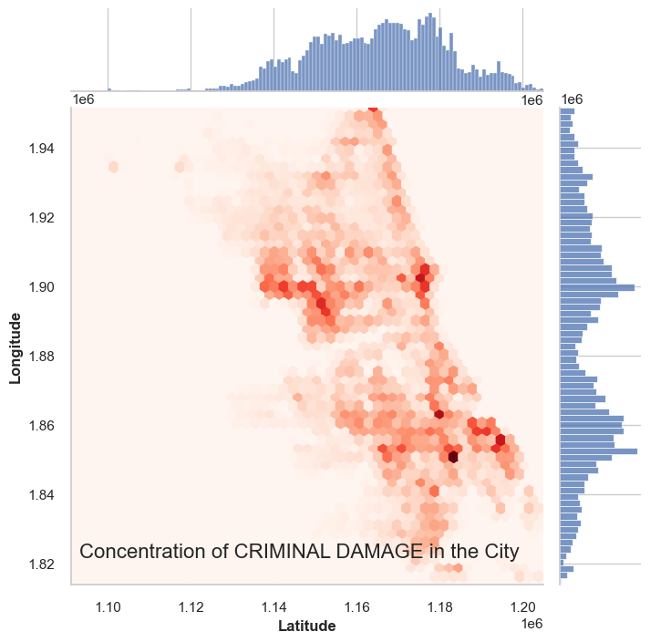
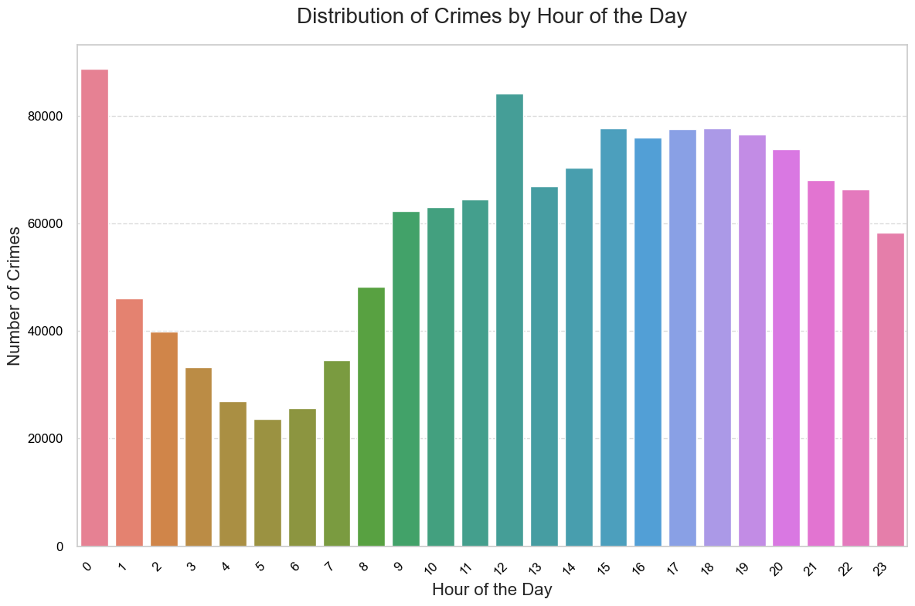
Exploratory Data Analysis
Visualizations
Notes:
Some scatter joint plots for criminal Damage – there are more graphs for the same and Distribution of Crimes by hour of the day
This code segment prompts the user to input a specific type of crime they are interested in analyzing. Here's an explanation of each part:
c = input("Enter the crime you wish to see the concentration of in the city >> "): This line prompts the user to enter the type of crime they want to analyze. The input is stored in the variable c.
crime_df = df[df['Primary Type']==c.upper()]: This line filters the DataFrame df to create a new DataFrame (crime_df) containing only the rows where the "Primary Type" column matches the crime entered by the user (c). The .upper() method is used to ensure that the input is converted to uppercase to match the case in the DataFrame.
sns.jointplot(): This function creates a joint plot to visualize the relationship between the latitude and longitude coordinates of the selected crime incidents. It uses hexagonal binning (kind='hex') to represent the concentration of data points.
x=crime_df['X Coordinate'].values, y=crime_df['Y Coordinate'].values: These parameters specify the X and Y coordinates to be plotted on the joint plot. They are extracted from the crime_df DataFrame.
height=7: This parameter sets the height of the joint plot to 7 inches.
plt.xlabel() and plt.ylabel(): These functions set the labels for the x-axis and y-axis of the joint plot, respectively. They provide information about the geographical coordinates being plotted (latitude and longitude) and set the labels' font styles to bold.
Overall, this code segment allows the user to input a specific type of crime, and then generates a joint plot to visualize the concentration of that crime type across the city of Chicago based on its latitude and longitude coordinates.

Slide 9
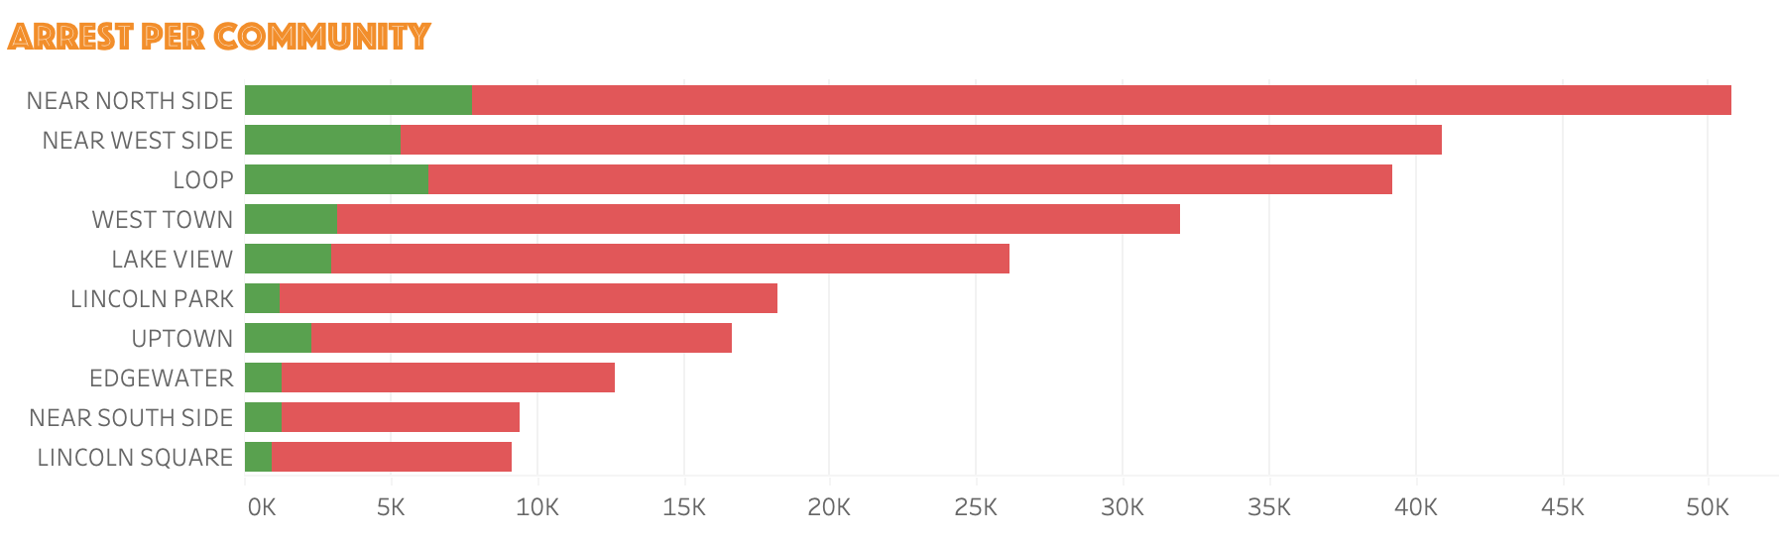
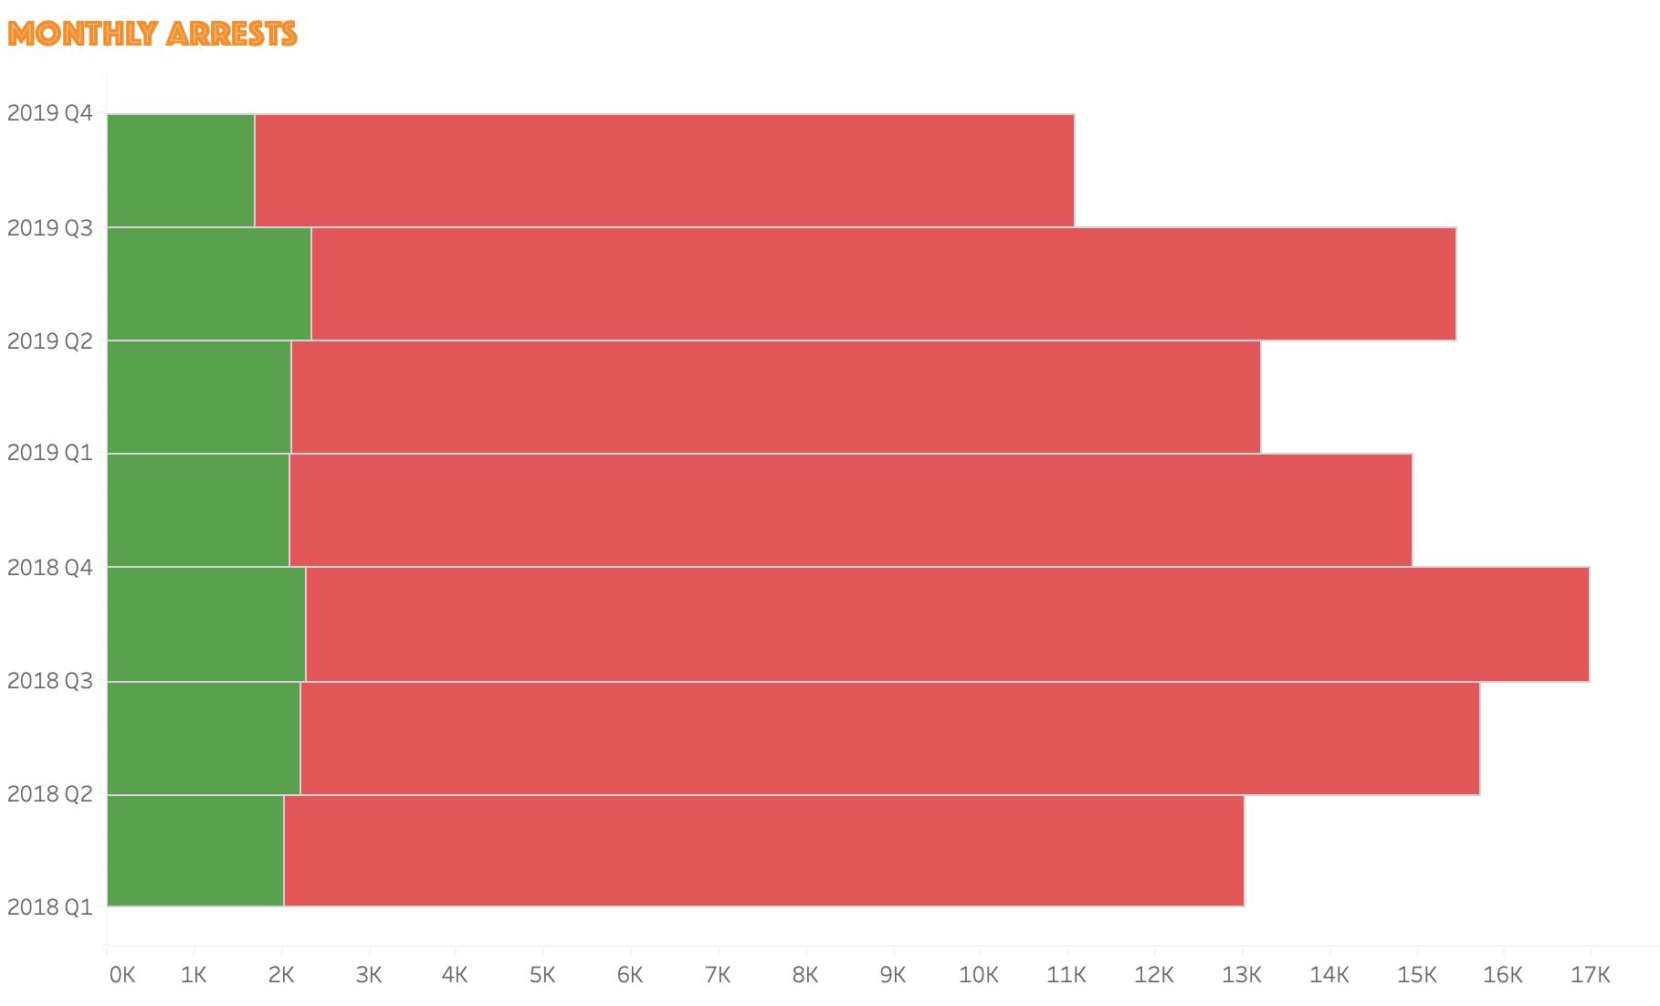

Analysis & Results
Top 10 Richest Communities of Chicago
Near North Side
Loop
Lake View
Lincoln Park
Near South Side
Near West Side
West Town
Edgewater
Lincoln Square
Uptown
Notes:
Monthly and per community arrests

Slide 10
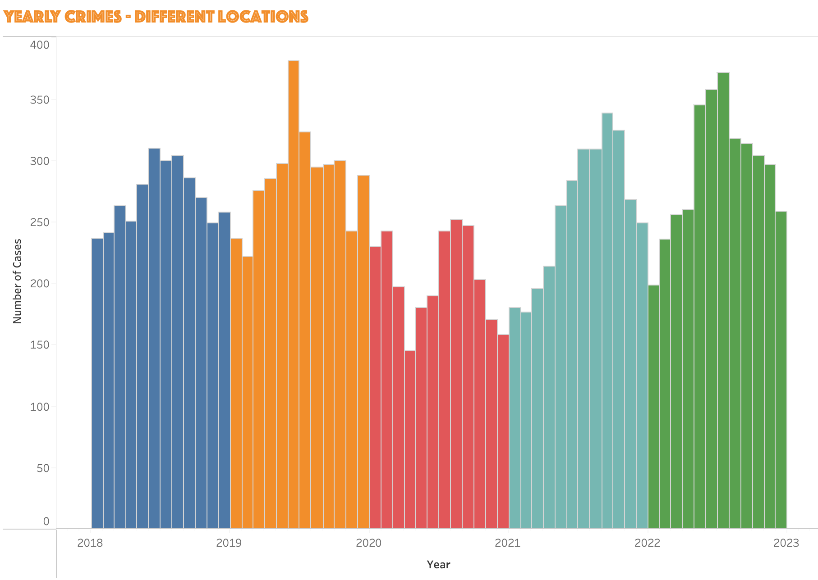
Analysis & Results
Top 10 Richest Communities of Chicago
Near North Side
Loop
Lake View
Lincoln Park
Near South Side
Near West Side
West Town
Edgewater
Lincoln Square
Uptown
Notes:
Collective number of cases in those communities

Slide 11
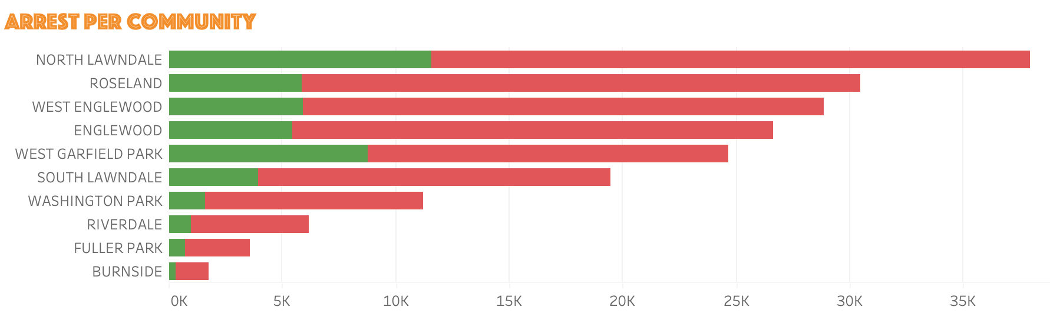
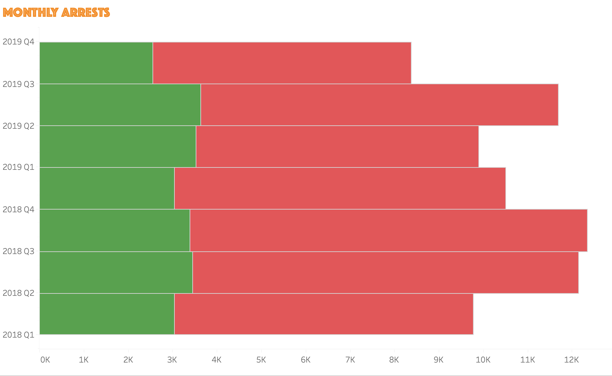
Analysis & Results
Top 10 Poorest Communities of Chicago
Fuller Park
Riverdale
West Englewood
Englewood
Washington Park
West Garfield Park
South Lawndale
North Lawndale
Burnside
Roseland
Notes:
Monthly and per community arrests

Slide 12
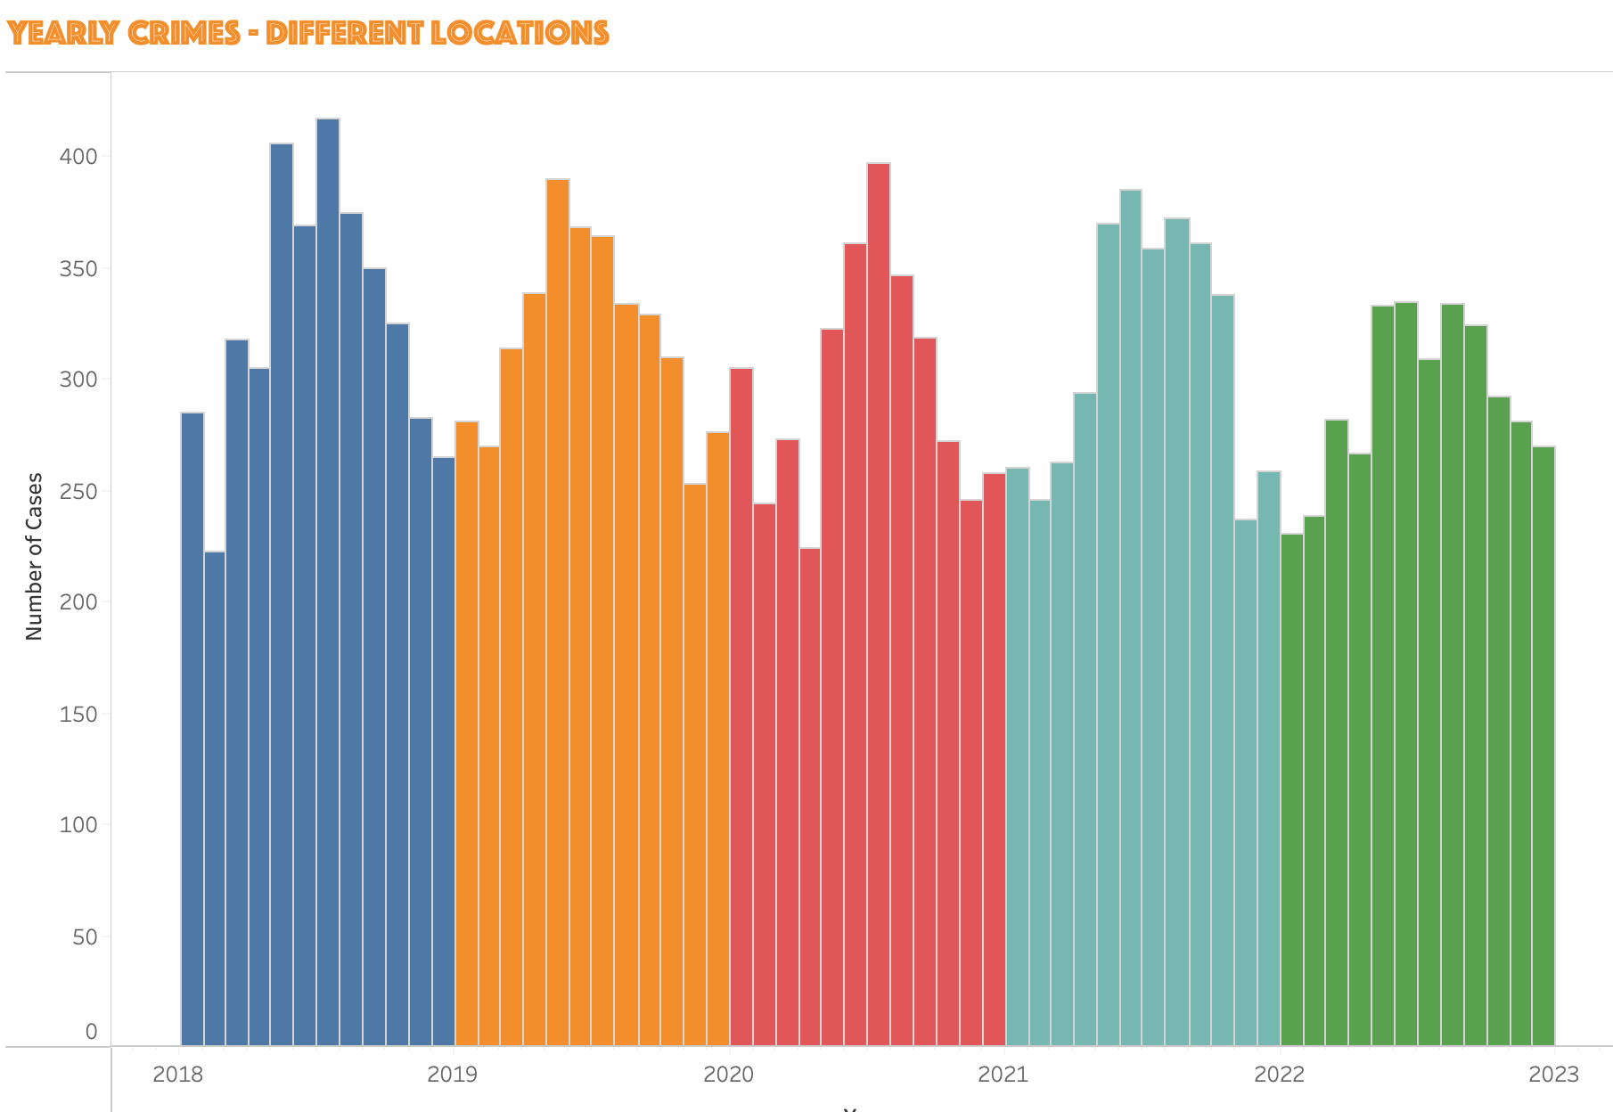
Analysis & Results
Top 10 Poorest Communities of Chicago
Fuller Park
Riverdale
West Englewood
Englewood
Washington Park
West Garfield Park
South Lawndale
North Lawndale
Burnside
Roseland
Notes:
Collective number of cases in those communities

Slide 13
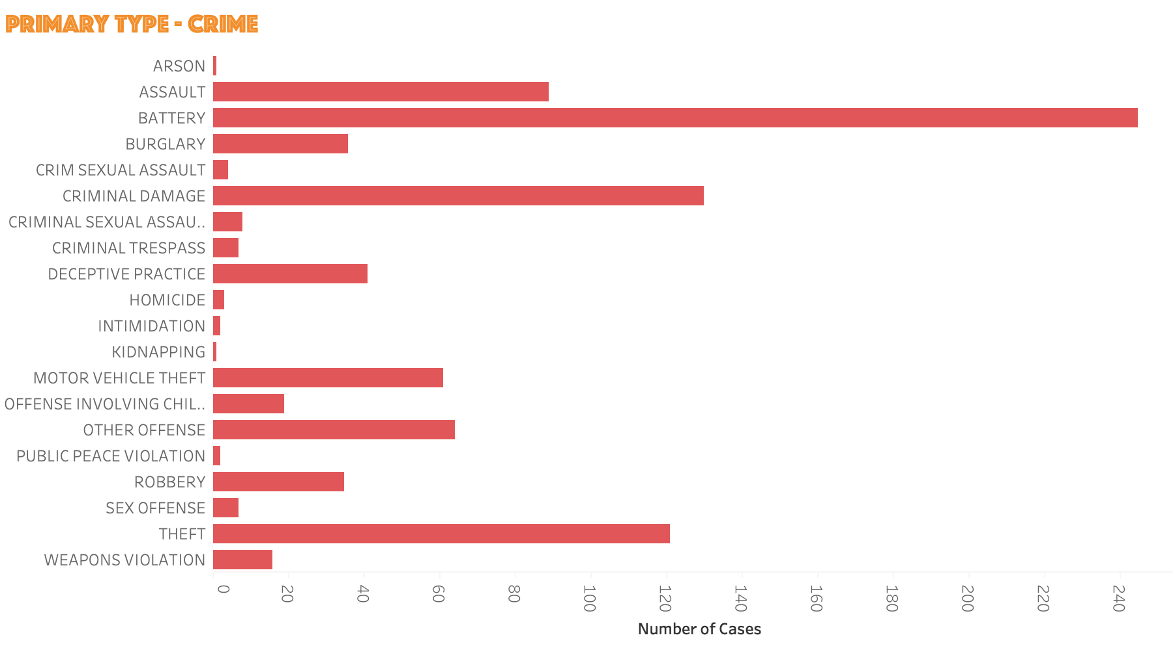
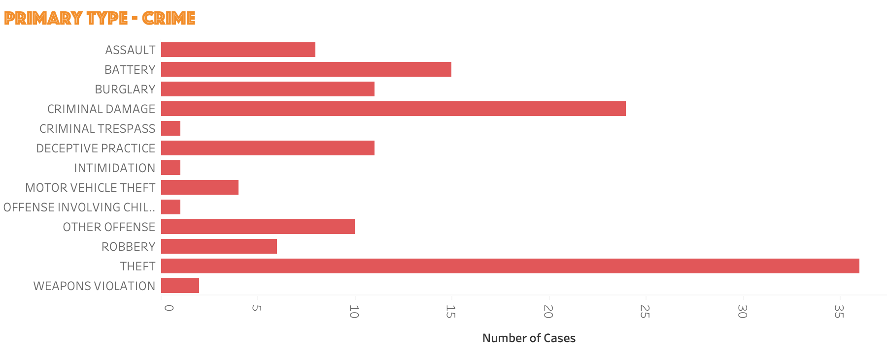
Poor Communities
Rich Communities

Slide 14

DashBoard

Slide 15
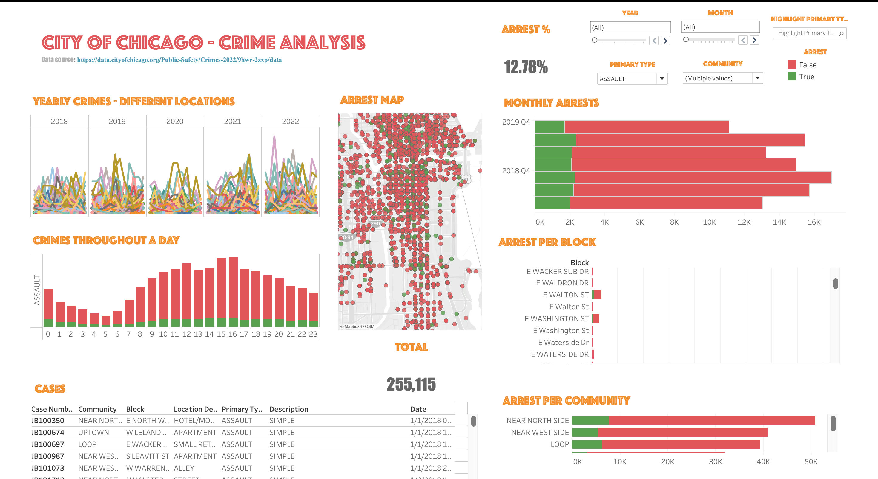
Notes:
Visualizing daily dependencies across our daily batch will enable batch processing teams to better understand potential impacts of an outage or failure.
The app we are developing will provide the ability to view the daily batch schedule as a whole and look for opportunities to optimize the schedule and deliver data to the business faster.
The application will serve as a link between the technical batch processing teams and the business to provide a complete visualization of all batches running in Zena.

Slide 16
Conclusion
Difference in Nature of Crimes
Difference in Number of Cases (Count of Cases)
There is a Direct Relation between POVERTY & CRIMES
Notes:
Data helps businesses make faster and smarter decisions. Being able to access this data more efficiently and at scale will help our clients by enabling us to make data driven decisions for them.
Scalable data infrastructure allows for better handling of customer data, which will make for a better customer experience
The data lake allows for more security to protect client and business data, which builds trust among clients.
Overall, a data lake allows for large volumes of data to be handled effectively, which results in improved services and greater satisfaction.

Slide 17

WHAT MORE CAN BE DONE ?

Slide 18
Thank you!
Questions?

